Slide 1
Degree in Computing Year 3
Rich Web Applications
Lecturer: Orla McMahon
Room: E010
Email: orla.mcmahon@itb.ie
Enrollment Key : richweb14
Notes:
Moodle: RWA2013

Slide 2

O. McMahon

Slide 3
Aims for this Semester
Practical Experience in developing Rich Web Applications within the area of AJAX, XML/JSON, jQuery and Mobile Applications.
I like the overall streamline factor of making
websites look and feel incredibly interactive,
and moving away from the old horrible blocky
style of my previous web projects
Quote from Student
O. McMahon

Slide 4
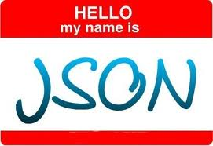


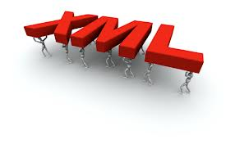

What does this mean
O. McMahon

Slide 5

Learning Outcomes
XML/JSON
AJAX
Current trends
in RWA
jQuery
for Web Applications
jQuery
Mobile
O. McMahon

Slide 6

1ST Year
O. McMahon

Slide 7

2nd Year
O. McMahon

Slide 8
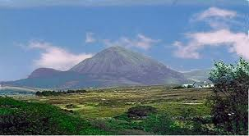
3RD Year
O. McMahon

Slide 9
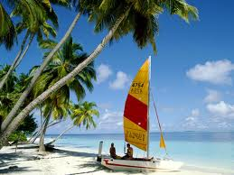
4TH Year
O. McMahon

Slide 10
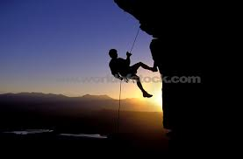
4th Year
O. McMahon

Slide 11
House Keeping
Bring a printed copy
of lecture notes and pen
and paper to class
every week
O. McMahon

Slide 12
Indicative Syllabus
JavaScript
  Grammar, Form Validation, Window Events
Document Object Model
XML, JSON
  What are they
  XML VS. JSON
AJAX
  Using AJAX with PHP
  AJAX and jQuery
Frameworks
  jQuery – Desktop and Mobile
Real World Examples
O. McMahon

Slide 13

Recommended Books
Recommended Book Resources
Learning jQuery , Chaffer and and Swedberg
E-Learning:
http://blanchlib.itb.ie/search/i?SEARCH=9781449331108&sortdropdown
jQuery Mobile up and Running, Maximiliano Firtman
Foundations of AJAX, Asleson, Schutta
SAMS teach yourself AJAX, Javascript and PHP all in one, Ballard, Moncour
Other Resources
Internet based resource:
http://www.jquery.com
http://jquerymobile.com
O. McMahon

Slide 14
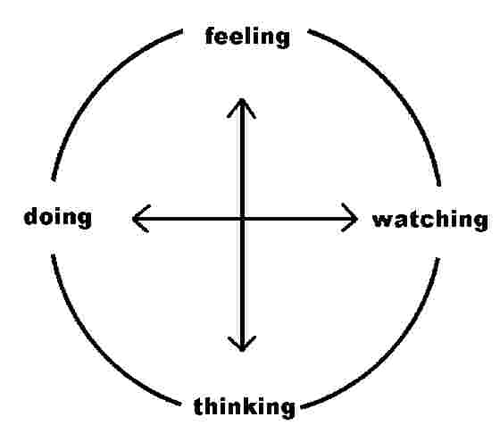
Weekly Hours
2 Hour Lecture (includes Active Learning)
2 Hour Practical
Independent Learning
O. McMahon

Slide 15
Some Ground Rules
Course will have project assignments.
Everything on the course is examinable.
Marks from the assignment will count towards your final mark.
All assignment work must be word-processed and printed
- use the college computer laboratories for this.
(Exceptions are active learning exercises in Lectures)
Hand written work will not be accepted for your assignments.
Ask questions and give feedback on course.
All mobile phones must be turned off in class.
O. McMahon

Slide 16




Assessment
O. McMahon

Slide 17
Assessment
Continuous Assessment (100%)
Weekly work
Assignment 1 (Web Application)
Assignment 2 (Web Application for Mobile)
O. McMahon

Slide 18
This Week
JavaScript
What is it?
JavaScript
Grammar
Differences between Java
and JavaScript
JavaScript
examples
JavaScript
Functions
Events
O. McMahon

Slide 19
What is JavaScript?
A programming language that adds interactivity to your web pages
AKA “a scripting language”
A JavaScript is a program that is included on an HTML page
JavaScript are scripts on Web pages that are interpreted and run by web browsers
O. McMahon

Slide 20
JavaScript is not Java
Used to be “LiveScript”
Renamed to ride the Java wave
O. McMahon

Slide 21
What can you do with JavaScript?
Create an active user interface
Validate user forms
Need to know JavaScript to work with AJAX and jQuery
O. McMahon

Slide 22
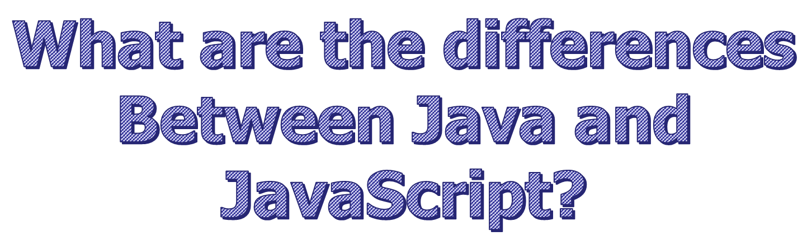
O. McMahon

Slide 23
Differences between Java and JavaScript
  1. Execution
  Java source code is compiled on the server into byte code, then sent to the client for execution as an applet.
  The Java Virtual Machine (e.g. a browser which can execute applets) must be resident on the client in order to execute this.
  JavaScript code is embedded as ASCII text within the HTML document itself.
  Browser must include a JavaScript interpreter which executes the JavaScript line by line.
  In summary Java is compiled, JavaScript is interpreted.
O. McMahon
Notes:
JavaScript invented by Netscape communications
Java invented by Sun

Slide 24
Differences between Java and JavaScript
  2. Object Methodology
  Java is a strict object-oriented programming language in that everything has to be developed as an object by the programmer.
  JavaScript is object based .
  It has no classes or inheritance but otherwise uses most of the ideas of object-orientation.
O. McMahon

Slide 25
Differences between Java and JavaScript
  3. Use in HTML
  Java is a separate language whose programs are created and stored independently of the HTML which might call them.
  It is called in the same way we might call an image file or sound file.
  JavaScript is embedded plain text within the HTML document or called as a separate file within the HTML document.
  It can only be executed when the enclosing HTML file is loaded into a browser.
O. McMahon

Slide 26
Differences between Java and JavaScript
4. Language Scope
Java is designed as a general purpose fully-featured programming language suitable for developing a wide range of applications.
One of its uses is to provide a level of interactivity to web pages.
JavaScript is designed solely as a means of providing
interactivity to web pages
O. McMahon

Slide 27
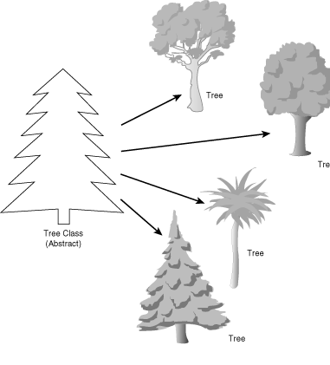
Objects
O. McMahon

Slide 28
Objects
Definition of a class
  A class is a generic template for a set of objects with similar features.
An instance of a class is another word for an actual object.
If class is the general (generic) representation of an object, an instance is its concrete representation.
O. McMahon

Slide 29
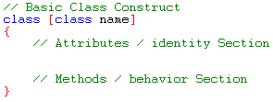
The Class Construct
It is essential that we understand and can use the class construct in Java. As we have seen in previous examples even our programs are defined by a classes.
Example -> Compact Disk
  Attributes
  Methods
O. McMahon

Slide 30
What’s this got to do with HTML?
  JavaScript regards the entire web document in which it is embedded as an object.
  All elements of the web page are also objects e.g. tables, forms, buttons, images etc…
  All of these objects have properties (information about the object) which can be directly accessed.
  For example one of the properties of the web document is its background colour.
  This can be directly altered in JavaScript by:
  document.bgColor = “red”
Object
Property
O. McMahon

Slide 31
What’s this got to do with HTML?
  Most objects have a set of things that they can do.
  Different objects can do different things.
  Each of the things that a document can do are methods.
  For example a document can write things to the screen.
  In JavaScript this is done using the write() method e.g.
    document.write(“Hello World”)
Object
Method
O. McMahon

Slide 32
What’s this got to do with HTML?
  How do we trigger these methods?
  JavaScript provides constructs for responding to events.
  For example we can place a button on a web page and trigger some method when the user clicks on it.
  Other events are things like:
  OnMouseOver,
  OnMouseOut,
  OnLoad.
O. McMahon

Slide 33
What does JavaScript look like?
  Here is a simple example.
    <html>
    <body> <br>
    This is HTML<br>
    <script language=“JavaScript”>
    document.write(“This is JavaScript”)
    </script>
    <br>This is HTML again!
    </body>
    </html>
  The bit inside the script tags is JavaScript.
  If you type this is and load into a browser you will see
      This is HTML
      This is JavaScript
      This is HTML again!
O. McMahon

Slide 34
  No big deal, could have done this without JavaScript.
  However it demonstrates the <script> tag.
  Everything inside is interpreted as JavaScript.
  document.write() outputs to the HTML page.
O. McMahon

Slide 35


Who invented the WWW?
O. McMahon

Slide 36

Who invented the Computer ?
O. McMahon

Slide 37
JavaScript Grammar
Variables
Operators
Expressions
  total=100;
Statements
  if (total>100) {statements;} else {statements;}
Objects
Functions / Methods
O. McMahon

Slide 38
Variables
JavaScript is Case Sensitive
  myvariable not the same as Myvariable
Variable names must start with a letter or underscore ("_"); subsequent characters can also be digits (0-9).
  Create a global variable by assigning it a value: myVariable = 5;
  Create a local variable using the keyword var:
  var myLocalVariable = 5;
O. McMahon

Slide 39
Data Type
JavaScript is a loosely typed language.
Data types are converted automatically as needed during script execution
String: - delineated by single or double quotation marks “Hello World”
Boolean:- can be True or False
Object: - myObj = new Object();
O. McMahon
Notes:
A loosely typed programming languages is typically one that does not require thetype of a variable to be explicitly stated. Perl is a loosely typed language. You can put anytype of data into a variable and perl will interpret it based on context:

Slide 40
Operators
Arithmetic:
  + - * / % ++ --
Comparison:
== != > >= < <=
Boolean:
  && || !
String:
+
Assignment:
= += -= *= /=
O. McMahon

Slide 41
Conditional Statements
  if (condition)
  { statements1; }
  else
  { statements2; }
switch (expression){
case label :
statement;
break;
case label :
statement;
break;
...
default : statement;
}
O. McMahon

Slide 42
Loops
FOR
for (initial-statement; test; increment)
{ statements; }
for (i=0; i<10; i++)
{ statements; }
WHILE
do
{ statements;}
while (condition)
while (condition)
{ statements; }
O. McMahon

Slide 43
Events
  Events are caused by user actions.
  We want to be able to write code to
  respond to these events.
  A simple event is the Click event.
  For example if the user clicks on a
  button then we might want a pop-up
  window to appear.
  The code on the following page illustrates
  this:
O. McMahon

Slide 44
Event Example (JS2.HTML)
<html>
<HEAD>
<SCRIPT LANGUAGE="JavaScript">
<!-- Begin
function drawAlert () {
alert ("This is an alert message that can say whatever you want!");
}
// End -->
</SCRIPT>
</head>
<BODY>
<CENTER>
<FORM>
<input type=button value="JavaScript Alert! Click Here!" onClick="drawAlert()">
</FORM>
</CENTER>
</body>
</html>
Function
O. McMahon
Eventhandler

Slide 45

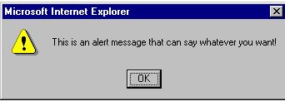
Event Example
Result
When you click on above button:
O. McMahon

Slide 46
Events
Usually functions are called by events
Events are actions that occur on the Web page,
EventHandler Called when . . .
onClick User clicks on form element or link
onChange User changes value of text, textarea,
or select element
onFocus User gives form element input focus
onBlur User removes input focus from form element
onMouseOver User moves mouse pointer over a link or anchor
onMouseOut User moves mouse pointer off of link or anchor
www.w3schools.com for examples
O. McMahon

Slide 47
Events (Contd.)
EventHandler Called when . . .
onSelect User selects form element's input field
onSubmit User submits a form
onResize User resizes the browser window
onLoad User loads the page in the Navigator
onUnload User exits the page
O. McMahon

Slide 48
Event Handlers
The event handler specifies which JavaScript code to execute.
Often, event handlers are placed within the HTML tag which declares the object on which the event acts.
Example
<a href=”url" onMouseOver="popupFunc();">
O. McMahon

Slide 49
Functions
  These are used to bundle sets of commands
  together in order to use them to respond to events.
  Here’s an example:
    <html>
    <script language=“JavaScript”>
    <!-- hide
    function Myfunction() {
    document.write(“Welcome to my page!<br>”);
    document.write(“This is JavaScript!<br>”);
    }
    myFunction();
    myFunction();
    myFunction();
    // -->
    </script>
    </html>
  .
  This will display
  “Welcome to my page”
  “This is JavaScript”
  3 times
O. McMahon

Slide 50
Functions
  Functions are generally used in conjunction with event-handlers. Consider this example:
  Function1.HTML
    <html>
    <head>
    <script language=“JavaScript”>
    <!-- hide
    function calc() {
    var x = 12;
    var y = 5;
    var result = x+y;
    alert(result);
    }
    //-->
    </script>
    </head> <body> <form>
    <input type=“button” value=“Calculate” onClick=“calc()”>
    </form> </body> </html>
O. McMahon

Slide 51

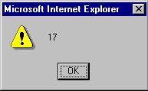
Functions
Result of Previous Example
The previous example is displayed in the browser as follows:
When you click on the ‘calculate’ button the result is displayed
as follows:
O. McMahon

Slide 52
Functions
  The button calls the function calc().
  It defines variables, gives them values and fires up a pop-up window with the results of a calculation.
  Obviously for this to do anything useful we should be able to pass the function values. JavaScript allows this also.
O. McMahon

Slide 53

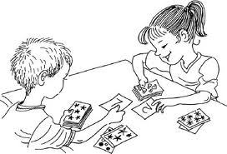
I am the card game that noone over 21 wins?
O. McMahon
Notes:
Blackjack

Slide 54
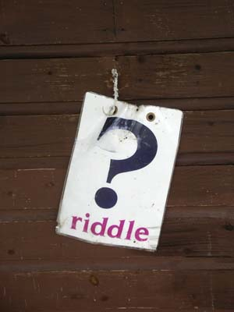
Riddle
What is it that the more you take the more you leave behind?
O. McMahon
Notes:
footprints

Slide 55
Internal vs. External Scripts
HTML example (script1.html)
<html>
<head>
<title>My next script</title>
<script type="text/javascript" src="script.js">
</script>
</head>
<body>
<h1>Hello, World! in HTML</h1>
<h1>
<script type="text/javascript">
document.write("Hello, World! in JavaScript");
</script>
</h1>
<h1 id="helloMessage">
</h1>
</body>
</html>
External JavascriptFile
Unique Object id
O. McMahon

Slide 56
Internal vs. External Scripts
JavaScript (script.js)
window.onload = writeMessage;
function writeMessage() {
document.getElementById("helloMessage").innerHTML = "Hello, world! from an external script";
}
O. McMahon

Slide 57
Internal vs. External Scripts
Notes
window.onload -> when the web page finishes loading call function writeMessage
document.getElementById("helloMessage").innerHTML = “Hello World….”
get the element where id = “helloMessage” and set its value to “Hello World…”
innerHTML changes the html inside the h1 tag in this case
Unique object id gives a unique name to the object on your page, eg “helloMessage” in the h1 tag
O. McMahon

Slide 58
Squareroot Calculator
The following example asks the user for an number and then displays the square root of the number entered.
O. McMahon

Slide 59
Squareroot Calculator
script3.html
<html>
<head>
<title>Square Root Calculator</title>
<script type="text/javascript" src="script3.js">
</script>
</head>
<body>
<noscript>
<h2>This page requires JavaScript.</h2>
</noscript>
</body>
</html>
O. McMahon

Slide 60
Squareroot Calculator
script3.js
window.onload = initAll;
function initAll() {
var ans = prompt("Enter a number","");
try {
if (!ans || isNaN(ans) || ans<0) {
throw new Error("Not a valid number");
}
alert("The square root of " + ans + " is " + Math.sqrt(ans));
}
catch (errMsg) {
alert(errMsg.message);
}
}
O. McMahon

Slide 61
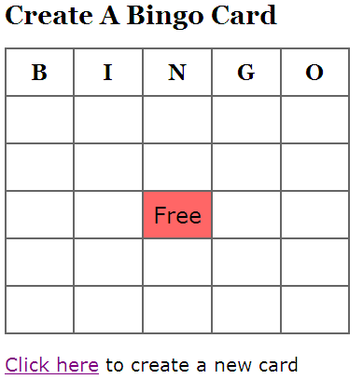
Bingo Card Example
In the following examples a bingo card is displayed as follows:
O. McMahon

Slide 62
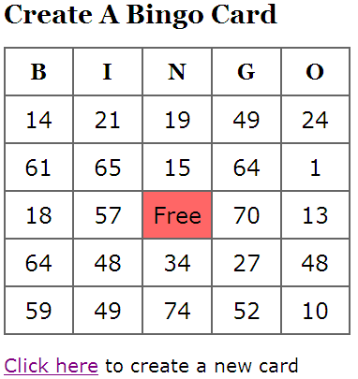
Bingo Card Example
When the user clicks on “click here” a new bingo card is displayed:
O. McMahon

Slide 63
Bingo Card Example (bingocard.html)
<html>
<head>
<title>Make Your Own Bingo Card</title>
<link rel="stylesheet" rev="stylesheet" ref="bingocard.css" />
<script type="text/javascript" src="bingocard.js">
</script>
</head>
<body>
<h1>Create A Bingo Card</h1>
<table>
<tr>
<th width="20%">B</th>
<th width="20%">I</th>
<th width="20%">N</th>
<th width="20%">G</th>
<th width="20%">O</th>
</tr>
<tr>
<td id="square0">&nbsp;</td>
<td id="square1">&nbsp;</td>
<td id="square2">&nbsp;</td>
<td id="square3">&nbsp;</td>
<td id="square4">&nbsp;</td>
</tr>
<tr>
<td id="square5">&nbsp;</td>
<td id="square6">&nbsp;</td>
<td id="square7">&nbsp;</td>
<td id="square8">&nbsp;</td>
<td id="square9">&nbsp;</td>
</tr>
External css file
External javaScript file
O. McMahon
Notes:
Bingocard example – Chapter 5 c2

Slide 64
Bingo Card Example (bingocard.html)
<tr>
<td id="square10">&nbsp;</td>
<td id="square11">&nbsp;</td>
<td id="free">Free</td>
<td id="square12">&nbsp;</td>
<td id="square13">&nbsp;</td>
</tr>
<tr>
<td id="square14">&nbsp;</td>
<td id="square15">&nbsp;</td>
<td id="square16">&nbsp;</td>
<td id="square17">&nbsp;</td>
<td id="square18">&nbsp;</td>
</tr>
<tr>
<td id="square19">&nbsp;</td>
<td id="square20">&nbsp;</td>
<td id="square21">&nbsp;</td>
<td id="square22">&nbsp;</td>
<td id="square23">&nbsp;</td>
</tr>
</table>
<p><a href=“bingocard.html" id="reload">Click here</a> to create a new card</p>
</body>
</html>
O. McMahon

Slide 65
Bingo Card Example (bingocard.css)
body {
background-color: white;
color: black;
font-size: 20px;
font-family: "Lucida Grande", Verdana, Arial, Helvetica, sans-serif;
}
h1, th {
font-family: Georgia, "Times New Roman", Times, serif;
}
h1 {
font-size: 28px;
}
table {
border-collapse: collapse;
}
th, td {
padding: 10px;
border: 2px #666 solid;
text-align: center;
font-size: 24px;
}
#free {
background-color: #F66;
}
O. McMahon

Slide 66
Bingo Card Example (bingocard.js)
window.onload = newCard;
function newCard() {
for (var i=0; i<24; i++) {
setSquare(i);
}
}
function setSquare(thisSquare) {
var currSquare = "square" + thisSquare;
var newNum = Math.floor(Math.random() * 75) + 1;
document.getElementById(currSquare).innerHTML = newNum;
}
O. McMahon

Slide 67
Bingo Card Example
Note that the css file and the javaScript file are external to the html program.
Notes on javaScript:
  document.getElementById(currSquare).innerHTML = newNum;
  This piece of code sets the value of “currSquare” to newNum,
  eg if new Num = 20 and currSquare = square1
  then square1 is set to 20.
O. McMahon

Slide 68
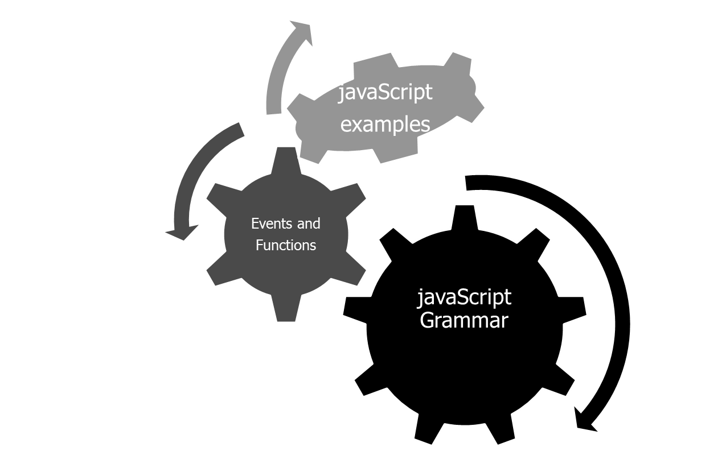

Summary
O. McMahon

